Slide 1

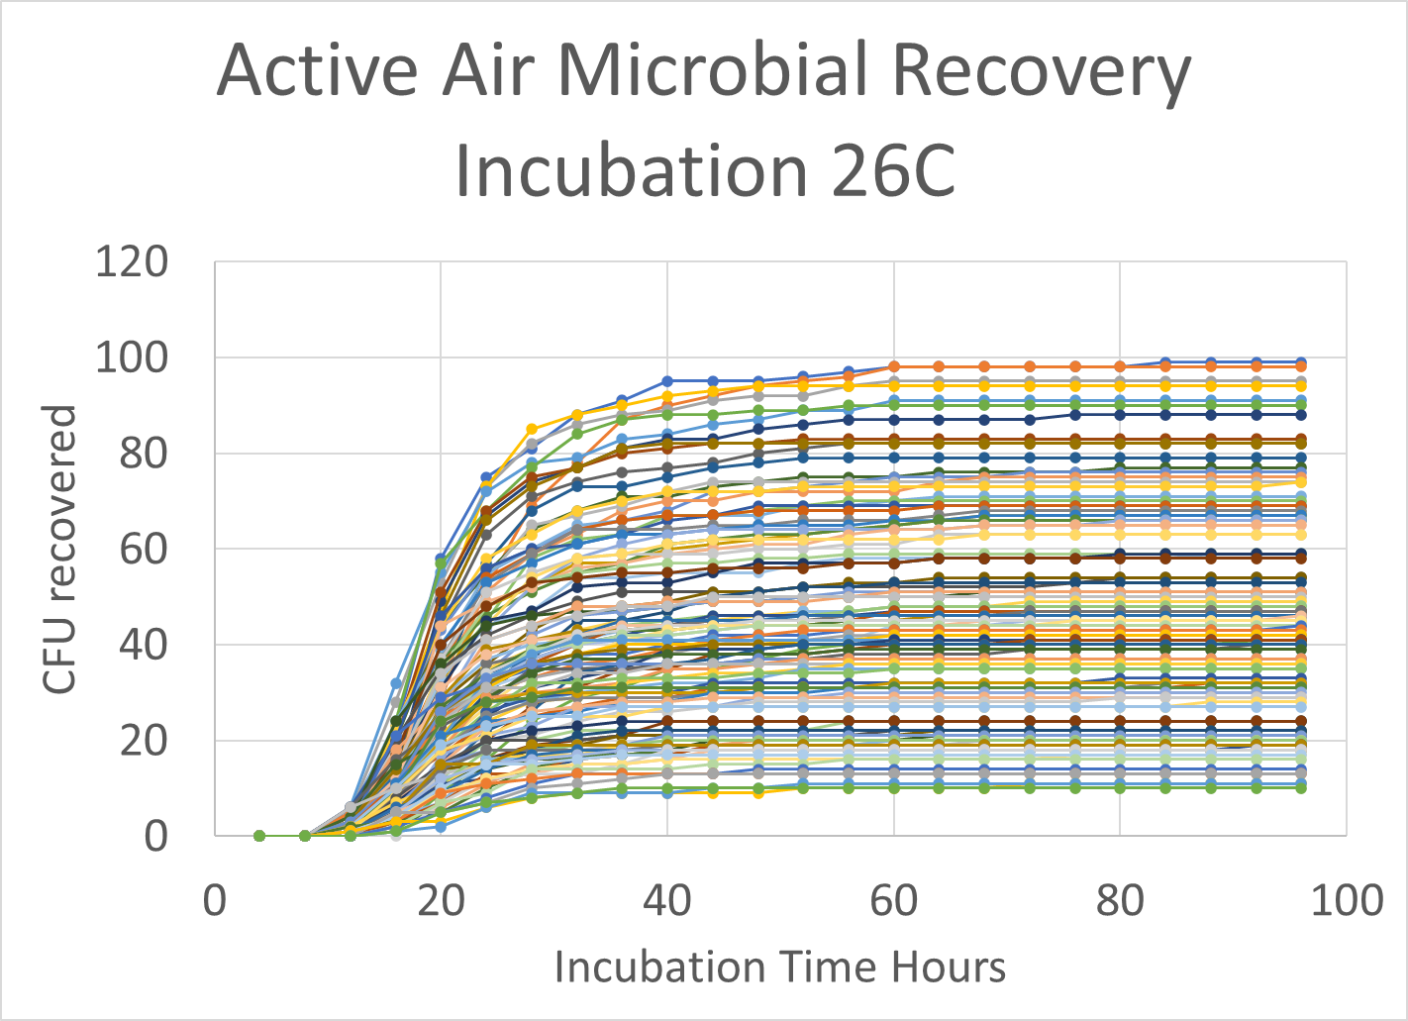
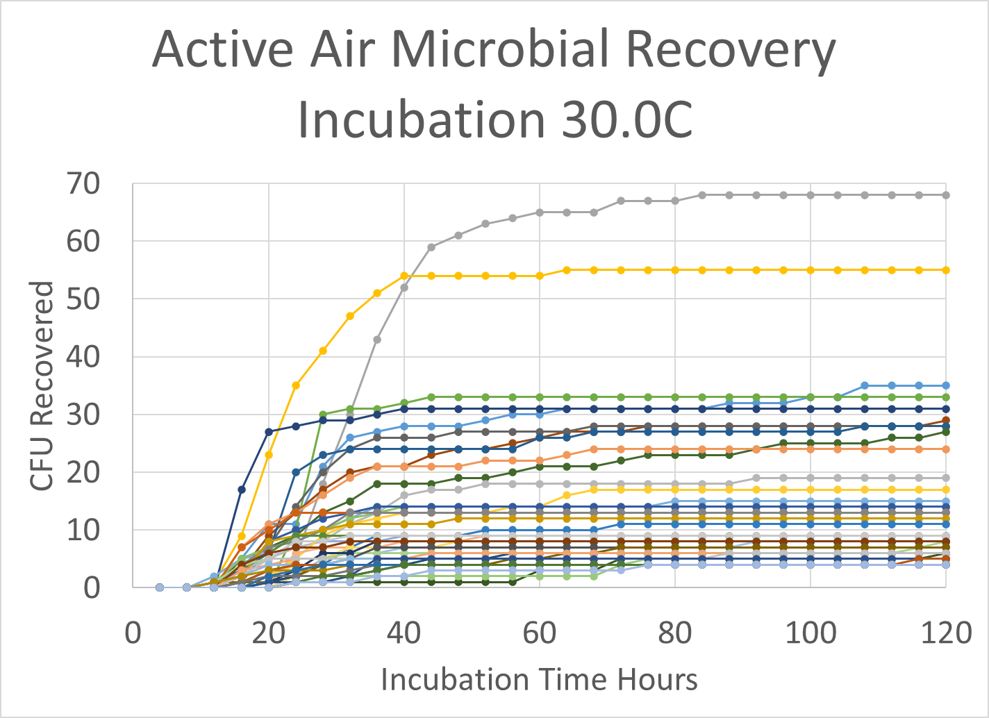
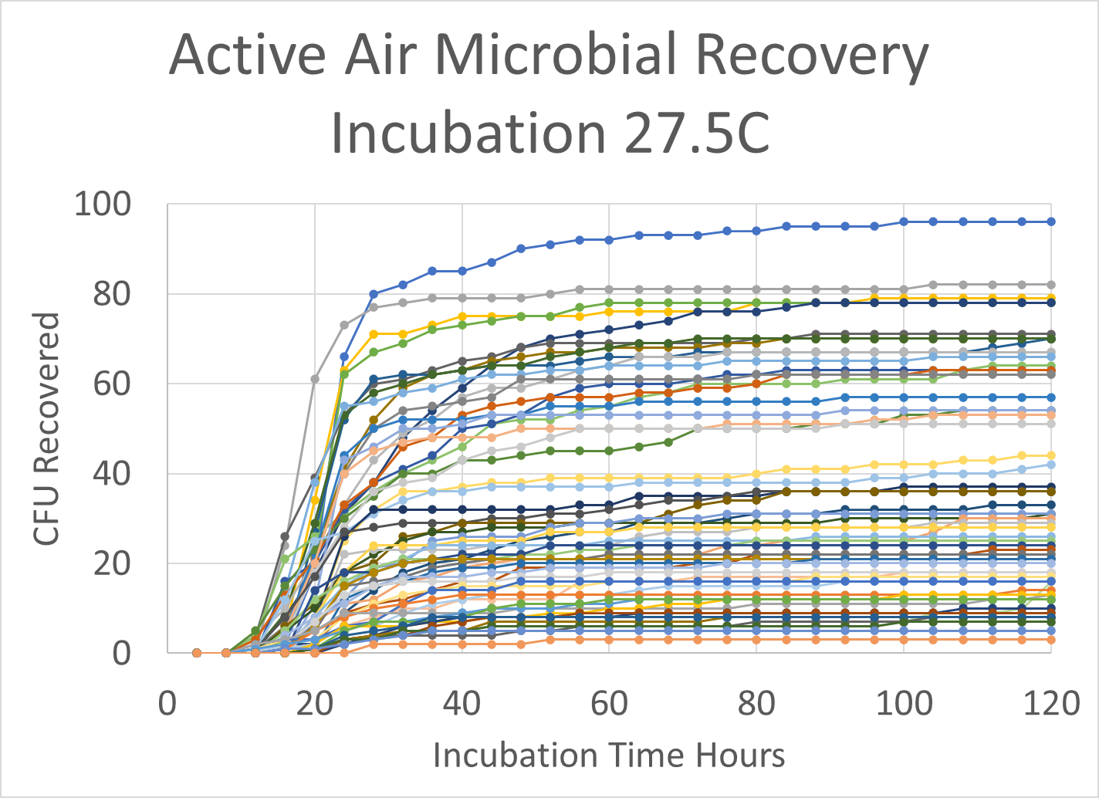
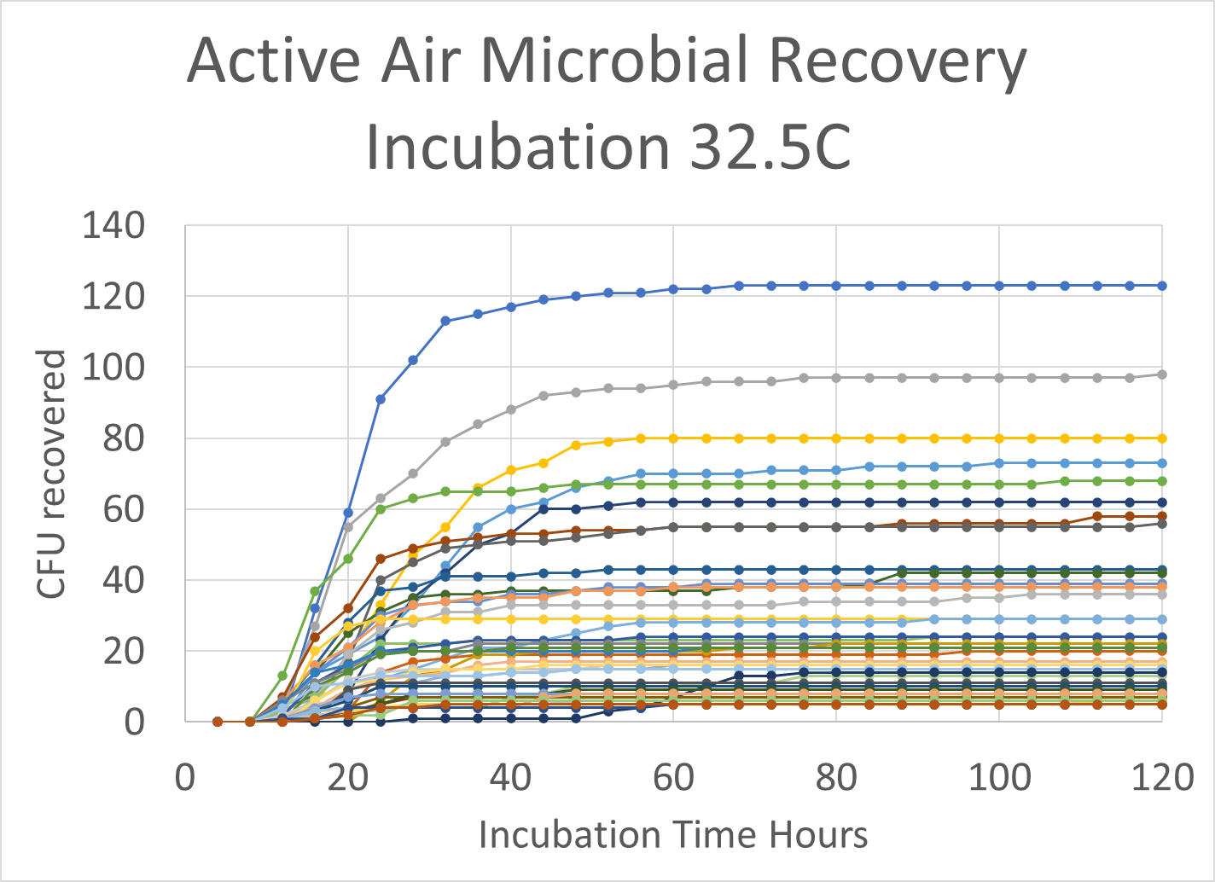
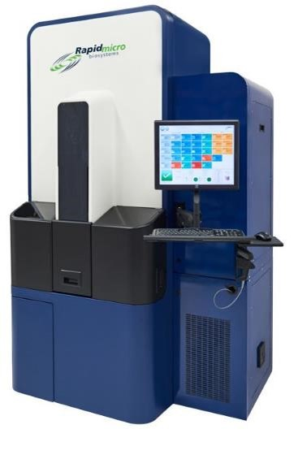
Determination and Comparison of Time-To-Results Across Global Sites for EM Media via RMM
Juan Rodriguez and David L. Jones, Rapid Micro Biosystems, Lowell, MA 01854, USA
Introduction
Environmental monitoring programs assess the effectiveness of cleaning and sanitation practices that have potential impact on controlled pharma environments.
Within the pharmaceutical industry, these programs are necessary and can play a critical role in acquiring, maintaining regulatory compliance and accreditation. When implementing the Growth Direct to perform EM testing shorter incubation times can be implemented due to the systems ability to detect microcolonies. The time to result (TTR) for the shorter incubation is established on a site-to-site basis due to the assumption that the environmental isolates found at each site will possess significant growth rate variations. This poster intends to illustrate that the there is an opportunity to establish a singular global incubation period for environmental monitoring programs
Technology
  The membrane on Rapid Micro Biosystem’s EM cassette is essential for the detection of microbial growth by the Growth Direct™ System. The Growth Direct System is a rapid enumeration platform that detects microbial growth based on auto fluorescent emissions from growing micro-organisms. Blue LED lights illuminate the cassettes and cause the microorganisms to auto fluoresce. A CCD camera detects the fluorescence and records growth throughout incubation. Each cassette is supplied with an 0.45-micron pore size membrane placed on top of standard microbiological EM growth media. The black membranes reduce the background fluorescence and generate a better signal to noise ratio for organism detection.
Results
The charts are examples of the data obtained during validation of the TTR value. The charts show the cumulative colony detection seen at each of the 4 hour read intervals used by the Growth Direct. One company used EM isolates found in facilities across the US, Europe, and Asia but tested at one facility under one condition in addition to local sample points in the facility. The remaining charts were from EM samples collected across different sample points in the facility and tested across the US or Europe using different incubation temperatures.
Discussion
The cumulative data generated to date from multiple sites, globally distributed, has confirmed that a TTR of ~72 hours will be equivalent to the traditional 5–7-day test. The 72-hour TTR appears to be independent of incubation temperature, 25 to 32.5°C using a single incubation temperature regime. To date every site validating the Growth Direct has either moved from a dual incubation regime or investigated the use of alternative incubation temperatures for their EM sample incubation. The incubation temperature chosen is highly site dependent and driven by organism distribution at the facility. The vast majority of sites are split between 25 to 30°C and 30 to 35°C as the incubation temperature of choice however all sites used 72 to 76 hours as their TTR.
Methodology
  Setting TTR can be performed in two ways, using micro-organisms from a historical collection found on site or testing the environment and determining the TTR from the organisms detected. If no organisms are found at the required test sites, e.g., in a class A environment then the former method is chosen. The TTR is defined as being the incubation time that allows detection of >85% of the colonies detected. The organism panel consisted of EM isolates often found in cleanroom environments from test sites across America and Europe in addition to real sample sites around the facility. The chart below shows the distribution of incubation temperatures implemented for EM testing globally using the Growth Direct..
The data below shows the TTR information for the pure culture samples from EM cultured storage strains is faster than the organisms found in the environment that were in a more stressed state due to dehydration or disinfectant treatments. The table below shows the max TTR determined at the 4 incubation temperatures validated and their geographical locations.
Global Distribution
Site | Temperature | Time-To-Result
West coast USA | 22.5 – 27.5 °C | 36 hours
Western Europe | 25 – 30 °C | 32 hours
Europe | 30 – 35 °C | 56 hours
Europe | 27.5 – 32.5 °C | 76 hours
Conclusion
Using the Growth Direct system, a validated Environmental Monitoring method can be instigated with results in ~72 hours using any incubation regime from 22.5-27.5 to 30-35 °C. These parameters are independent of global location and season.
Doc No TSV0250

