Slide 1
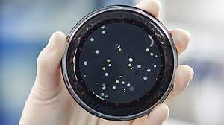
Compatible Air Samplers for RMB Cassettes
The following slides provide the different manufacturers, contact information, and important notes.
One important note which applies to all air systems, all options require some sort of adaptor. The request will always be for Rapid Micro Biosystems clips and head (if required).
Any questions or concerns, reach out to Eric Chenelle, Product Manager Applications. Echenelle@rapidmicrobio.com

Slide 2
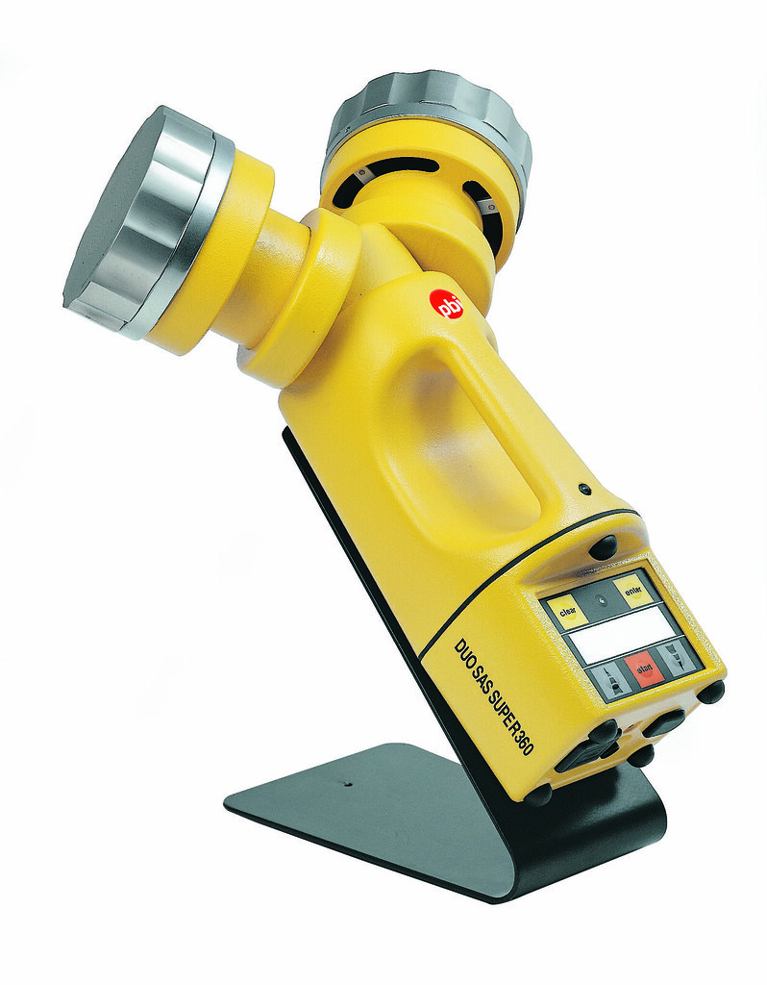
SAS from Biosciences International
SAS from Biosciences International
https://biosci-intl.com/products.htm
Peter Pratt
Ppratt@biosci-intl.com

Slide 3
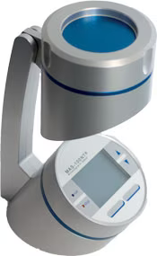
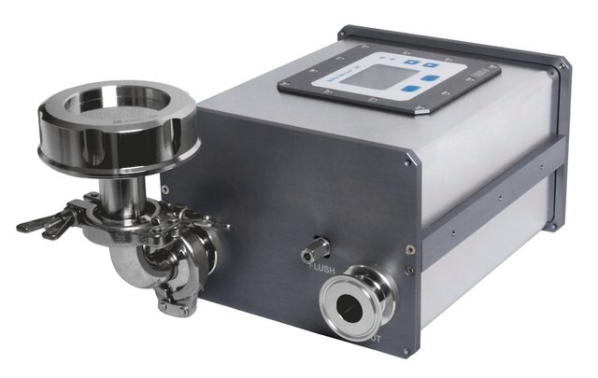
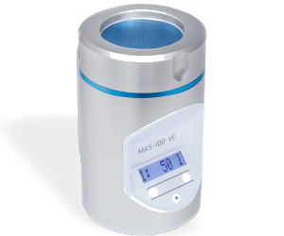
MAS -100 Family
MAS-100 Samplers
Multiple different options which are all compatible. Manufactured by MBV and sold predominantly by MilliporeSigma/Merck
https://www.sigmaaldrich.com/US/en/product/mm/109191
Order adaptor thru MilliporeSigma/Merck using catalog number 1.19166.0001.
If you run into issues, reach out to PdM
Contact PdM for Isolotor options since we need to work directly with MBV. Longer lead time for these stainless steel heads but it is an option.

Slide 4
PMS
PMS MiniCapt
https://www.pmeasuring.com/active-air-sampler/
Frank Panofen
FPanofen@PMEASURING.com
O: +49 (0) 5201 / 735730 M: +49 (0)170 8482331
Giulia Artalli
gartalli@pmeasuring.com
O: +39 06 90530130 M: +39 392 92 48 858

Slide 5
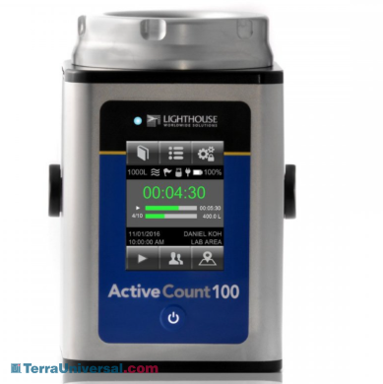
LightHouse
LightHouse
https://www.golighthouse.com/en/microbial-samplers/activecount/
Marcel Van Haaren
mvanhaaren@golighthouse.com

Slide 6
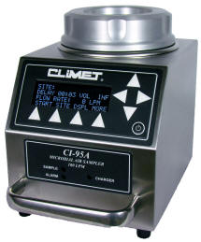
CLiMET
CLiMET
https://www.climet.com/products/ci97.html
(909) 793-2788
sales@climet.com

